Slide 1
Emotion Recognition using Speech Processing
Shri Shankaracharya Institute of Professional Management & Technology, Raipur
Project(Phase-I) Report on
CSE 7th Semester
Department of Computer Science and Engineering,
Batch 2020-2024
Session July – Dec 2023
Presentation Date:
Project Group Members:
Amit Prasad
Aalind Shukla
Project Guide
Mrs.Priyata Mishra
(Asst Prof, Department of Computer Science Engineering)

Slide 2
Introduction about Project
There are many ways of communication but the speech signal is one of the fastest and most natural methods of communications between humans.
Humans have the natural ability to use all their available senses for maximum awareness of the received message.
The emotional detection is natural for humans but it is very difficult task for machine.
Therefore the purpose of emotion recognition system is to use emotion related knowledge in such a way that human machine communication will be improved.
2

Slide 3
To understand an image and generate captions, we are proposing a Deep learning based method.
Deep learning can provide increased accuracy and decrease in computational power.
Deep neural network (DNN) has unprecedented success in the field of speech recognition and image recognition.
We found that the DNN in speech emotion processing has a huge advantage.
We used DNN to train a 5-layer-deep network to extract speech emotion features.

Slide 4
Application Area
Engaging in Speech Emotion Recognition (SER) is crucial for its diverse applications in virtual assistants, human-computer interaction, and affective computing. Accurately identifying emotions in spoken language enables the development of emotionally intelligent systems, enhancing user experiences and fostering advancements in various application areas.
1

Slide 5
Applications:
Customer Service and Support:
Utilizes SER to analyze customer emotions for improved service interactions.
Mental Health Monitoring:
Applies SER to monitor and assess emotional states for mental health support.
Market Research:
Leverages SER for gauging emotional responses in consumer feedback.
Voice Assistants and Virtual Agents:
Enhances virtual assistants with SER for emotion-aware interactions.
Call Centers and Sales:
Utilizes SER to analyze customer emotions in call center interactions for improved sales strategies.
1

Slide 6
Benefits:
Enhanced User Experience:
Improves user interactions with systems by adapting responses based on detected emotions.
Empathetic Virtual Assistants:
Enables virtual assistants to provide empathetic and contextually relevant responses.
Mental Health Support:
Facilitates emotion monitoring for mental health applications, aiding in timely interventions.
Optimized Customer Service:
Enhances customer service interactions by understanding and responding to customer emotions.
Insightful Market Research:
Provides valuable insights through emotion analysis in consumer feedback for market research.
1

Slide 7
End Users:
Developers/Researchers:
Involved in creating and advancing Speech Emotion Recognition (SER) technologies.
Affective Computing Professionals:
Utilize SER for emotion-aware applications in the field of affective computing.
Virtual Assistant Developers:
Integrate SER to enhance virtual assistants with emotion recognition capabilities.
HCI Specialists:
Leverage SER for improving Human-Computer Interaction experiences.
Tech Enthusiasts:
Interested in exploring and understanding the capabilities of SER technology.
1

Slide 8
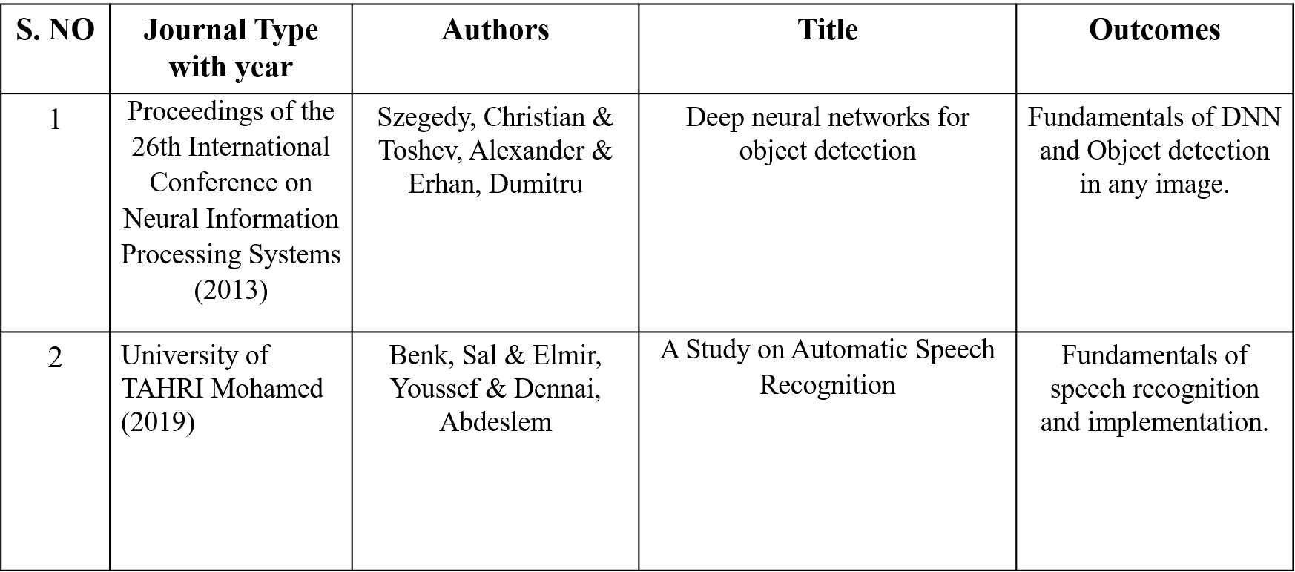
Literature Review
3

Slide 9
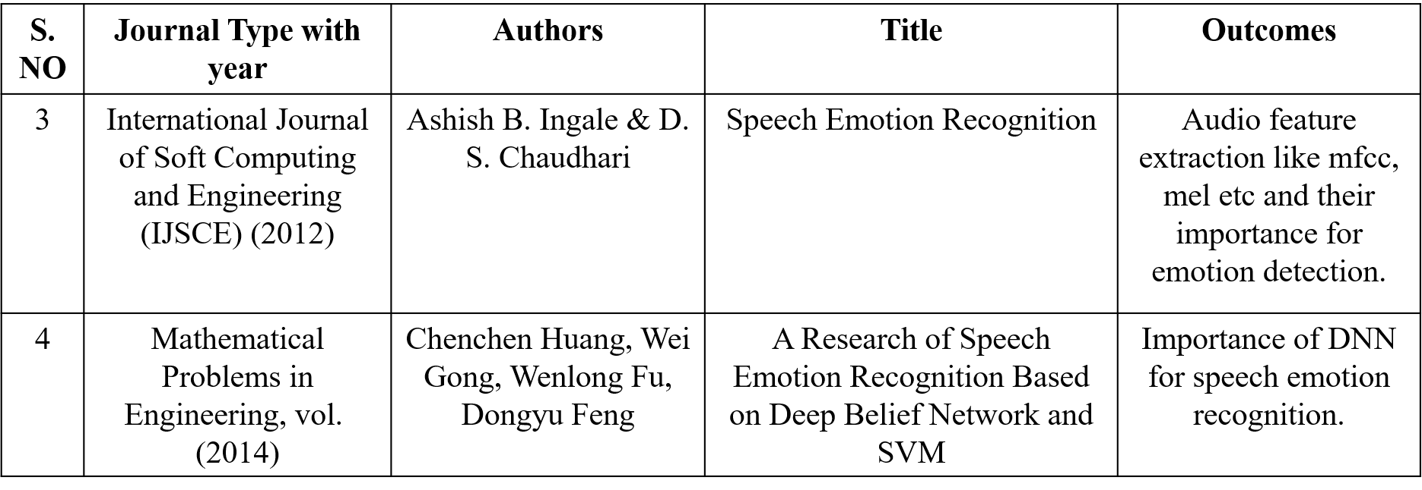

Slide 10
Methodology
Existing Method
In most of the currently available systems, the model used for emotion recognition uses traditional Machine learning algorithms.
The algorithm like Support Vector Machines, KNN etc were used in the past.
The accuracies of these models are low.
There are deep learning models for emotion recognition but they are trained on large datasets and are complex to use.
3

Slide 11
  Disadvantages in Existing method
  Lower accuracies.
  High computation complexities.
  Requires high performance hardware to achieve a model with good accuracy.

Slide 12
Proposed Method
We propose a modified speech emotion recognition method which uses deep neural networks for training.
The method uses Mel-frequency cepstral coefficients (MFCC), Chromogram, Mel scaled spectrogram in conjunction with Spectral contrast and Tonal Centroid features to extract details about an audio file.
The dataset used here is the Ryerson Audio-Visual Database of Emotional Speech and Song (RAVDESS).

Slide 13
Advantages in Existing method
Higher Accuracy.
Low computational complexities.
Does not requires very high performance hardware(s) to run.

Slide 14
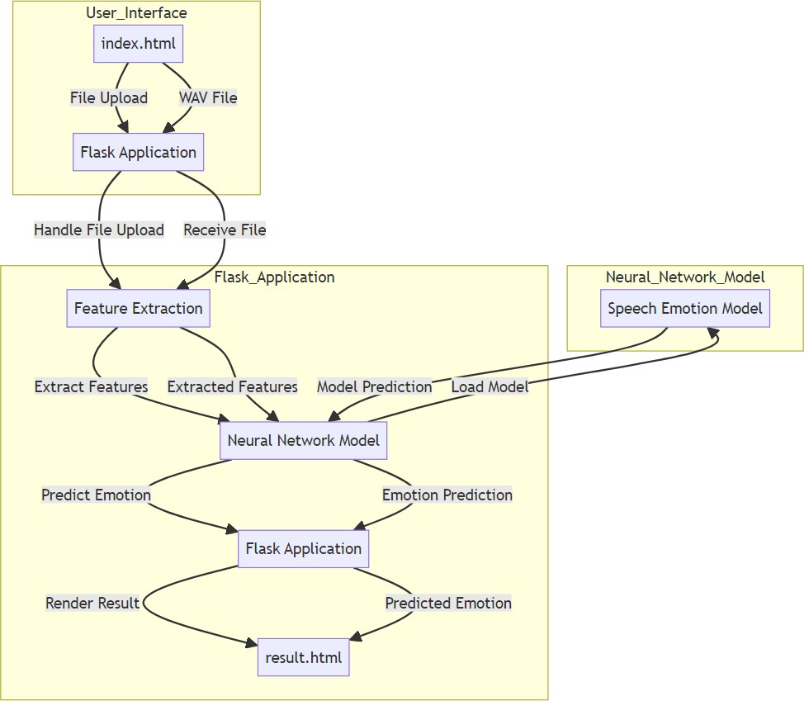
Project Work Flow Diagram
block diagram
12

Slide 15
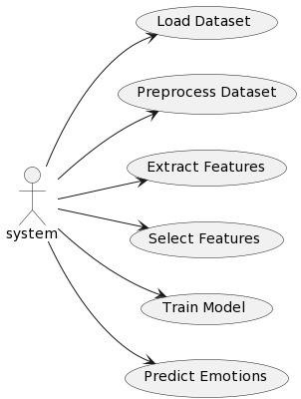
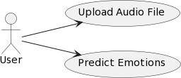
Use Case Diagram

Slide 16
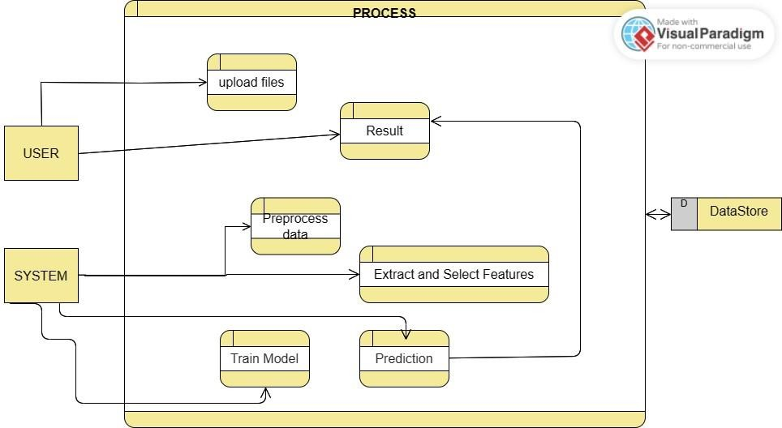
Data Flow Diagram

Slide 17
Result & Conclusion
The proposed scheme presented an approach to recognize the emotion from the human speech.
This approach has been implemented by the using the neural networks.
We have successfully developed a deep learning model using the deep neural network architecture to predict the emotions of the speaker in an audio.
We have famed our project in a web based application using the Flask architecture. The UI also includes user registration system.
We were able to get a test accuracy of 73.4% using the trained model.
13

Slide 18
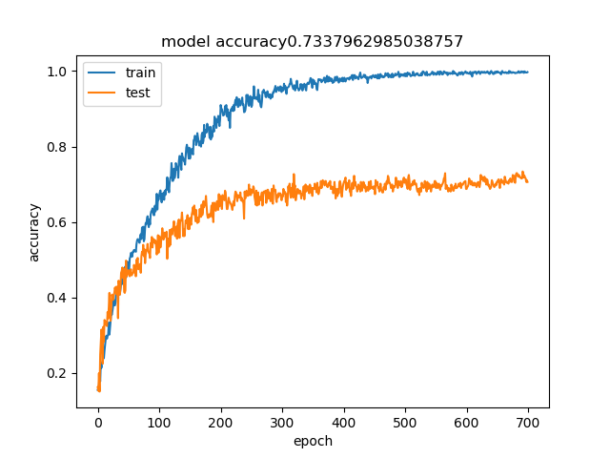
The train vs test accuracies of our model over 700 epochs are shown below:
The model gets the best test accuracy of 73.4%

Slide 19
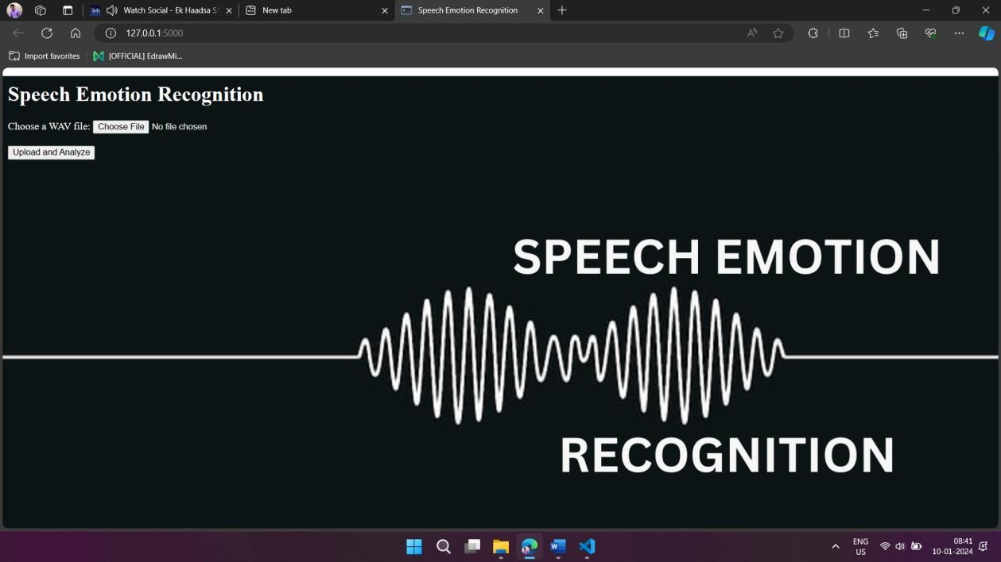
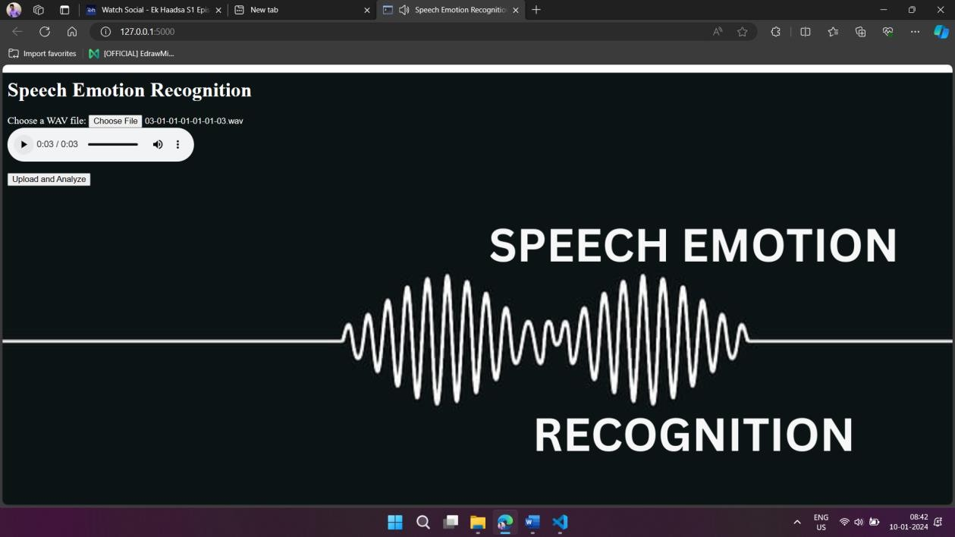
website snapshots

Slide 20
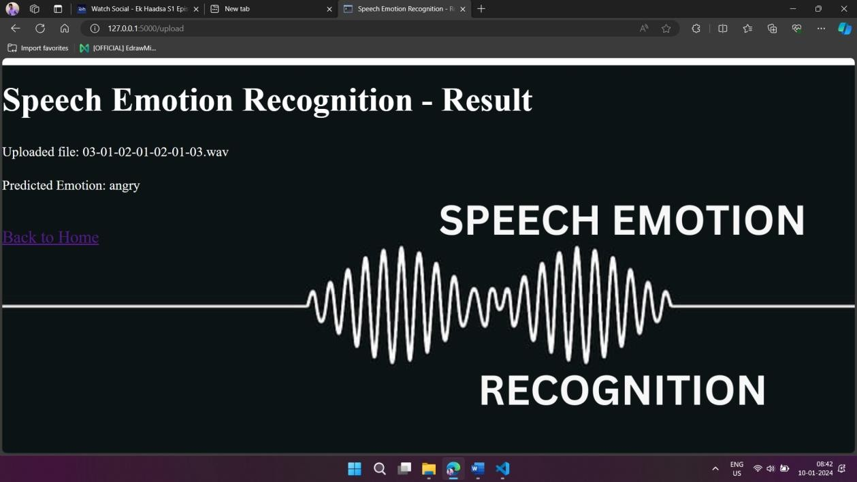
output

Slide 21
References
[1] Szegedy, Christian & Toshev, Alexander & Erhan, Dumitru. (2013). Deep Neural Networks for Object Detection. 1-9.
[2] Benk, Sal & Elmir, Youssef & Dennai, Abdeslem. (2019). A Study on Automatic Speech Recognition. 10. 77-85. 10.6025/jitr/2019/10/3/77-85.
[3] Ashish B. Ingale & D. S. Chaudhari (2012). Speech Emotion Recognition. International Journal of Soft Computing and Engineering (IJSCE) ISSN: 2231-2307, Volume-2 Issue-1, March 2012
[4] Chenchen Huang, Wei Gong, Wenlong Fu, Dongyu Feng, "A Research of Speech Emotion Recognition Based on Deep Belief Network and SVM", Mathematical Problems in Engineering, vol. 2014, Article ID 749604, 7 pages, 2014. https://doi.org/10.1155/2014/749604
[5] Livingstone SR, Russo FA (2018) The Ryerson Audio-Visual Database of Emotional Speech and Song (RAVDESS): A dynamic, multimodal set of facial and vocal expressions in North American English. PLoS ONE 13(5): e0196391.
15

Slide 22
[6] M. E. Ayadi, M. S. Kamel, F. Karray, “Survey on Speech Emotion Recognition: Features, Classification Schemes, and Databases”, Pattern Recognition 44, PP.572-587, 2011.
[7] I. Chiriacescu, “Automatic Emotion Analysis Based On Speech”, M.Sc. THESIS Delft University of Technology, 2009.
[8] T. Vogt, E. Andre and J. Wagner, “Automatic Recognition of Emotions from Speech: A review of the literature and recommendations for practical realization”, LNCS 4868, PP.75-91, 2008.
[9] S. Emerich, E. Lupu, A. Apatean, “Emotions Recognitions by Speech and Facial Expressions Analysis”, 17th European Signal Processing Conference, 2009.
[10] P.Shen, Z. Changjun, X. Chen, “Automatic Speech Emotion Recognition Using Support Vector Machine”, International Conference On Electronic And Mechanical Engineering And Information Technology, 2011.

Slide 23
Web Resources
https://proceedings.neurips.cc/paper_files/paper/2013/file/f7cade80b7cc92b991cf4d2806d6bd78-Paper.pdf
https://sist.sathyabama.ac.in/sist_naac/aqar_2022_2023/documents/1.3.4/b.e-cse-batchno-32.pdf
https://www.ijsce.org/wp-content/uploads/papers/v2i1/A0425022112.pdf
https://www.hindawi.com/journals/mpe/2014/749604/
https://journals.plos.org/plosone/article?id=10.1371/journal.pone.0196391
https://www.researchgate.net/publication/223848328_Survey_on_speech_emotion_recognition_Features_classification_schemes_and_databases
https://repository.tudelft.nl/islandora/object/uuid%3Aee4ac3cc-bcd1-41bb-9554-b55804ed6c9a
https://www.researchgate.net/publication/329336071_Automated_Speech_Emotion_Recognition_on_Smart_Phones
https://www.semanticscholar.org/paper/Automatic-Speech-Emotion-Recognition-using-Support-Shen-Zhou/55bbf11074c81dcb03ece3d2506cc0d4dcf740a5

